Slide 1
git intro
by Vyacheslav Koldovskyy

Slide 2
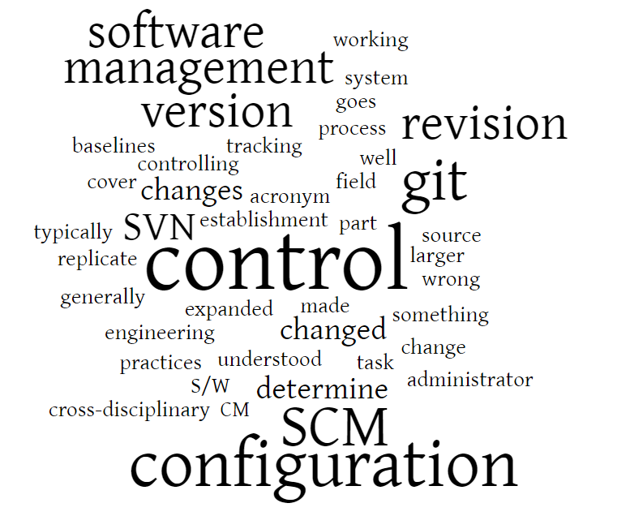
SCM/VC/RC/SC
A component software configuration management (SCM), version control (VC), also known as revision control (RC) or source control (SC) is the management of changes to documents, computer programs, large web sites, and other collections of information.
Notes:
A version control system serves the following purposes, among others.
Version control enables multiple people to simultaneously work on a single project. Each person edits his or her own copy of the files and chooses when to share those changes with the rest of the team. Thus, temporary or partial edits by one person do not interfere with another person's work. Version control also enables one person you to use multiple computers to work on a project, so it is valuable even if you are working by yourself.
Version control integrates work done simultaneously by different team members. In most cases, edits to different files or even the same file can be combined without losing any work. In rare cases, when two people make conflicting edits to the same line of a file, then the version control system requests human assistance in deciding what to do.
Version control gives access to historical versions of your project. This is insurance against computer crashes or data lossage. If you make a mistake, you can roll back to a previous version. You can reproduce and understand a bug report on a past version of your software. You can also undo specific edits without losing all the work that was done in the meanwhile. For any part of a file, you can determine when, why, and by whom it was ever edited.

Slide 3
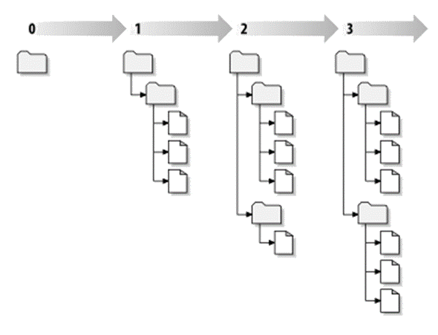
Typical tasks for version control systems
Tracking changes
Making updates
Getting updates
Resolving Conflicts
Diffing (viewing differences)
Branching and merging
Controlling change sets

Slide 4
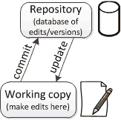
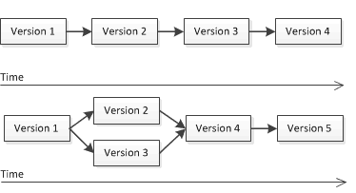
Terms
Repository
Working Copy
Merging
Version
Notes:
Version control uses a repository (a database of changes) and a working copy where you do your work.
Your working copy (sometimes called a checkout) is your personal copy of all the files in the project. You make arbitrary edits to this copy, without affecting your teammates. When you are happy with your edits, you commit your changes to a repository.
A repository is a database of all the edits to, and/or historical versions (snapshots) of, your project. It is possible for the repository to contain edits that have not yet been applied to your working copy. You can update your working copy to incorporate any new edits or versions that have been added to the repository since the last time you updated. See the diagram at the right.
In the simplest case, the database contains a linear history: each change is made after the previous one. Another possibility is that different users made edits simultaneously (this is sometimes called “branching”). In that case, the version history splits and then merges again.

Slide 5
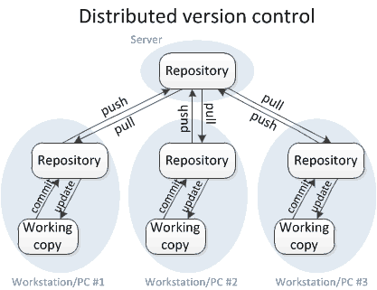
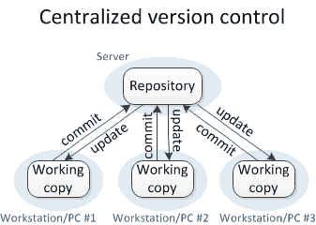
Types of Version Control Systems
CVS, Perforce, SVN, Team Foundation Server (TFS)
git, mercurial
Notes:
Centralized VCS – These systems, such as CVS, Subversion, and Perforce, have a single server that contains all the versioned files, and a number of clients that check out files from that central place. For many years, this has been the standard for version control. In centralized version control, each user gets his or her own working copy, but there is just one central repository. As soon as you commit, it is possible for your co-workers to update and to see your changes. For others to see your changes, 2 things must happen:
You commit
They update
Distributed VCS –
In distributed version control, each user gets his or her own repository and working copy. After you commit, others have no access to your changes until you push your changes to the central repository. When you update, you do not get others' changes unless you have first pulled those changes into your repository. For others to see your changes, 4 things must happen:
You commit
You push
They pull
They update
Notice!!! that the commit and update commands only move changes between the working copy and the local repository, without affecting any other repository. By contrast, the push and pull commands move changes between the local repository and the central repository, without affecting your working copy.

Slide 6

Git Intro
git – is a distributed version control system with an emphasis on speed, data integrity, and support for distributed, non-linear workflows.
git was initially designed and developed by Linus Torvalds for Linux kernel development in 2005, and has since become the most widely adopted version control system for software development.

Slide 7


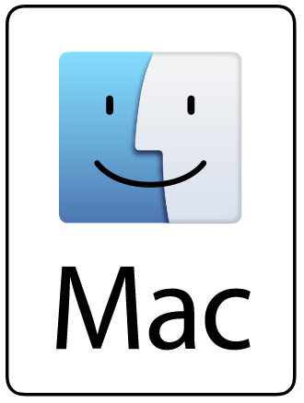
Install git
Linux OS
Debian Family (Debian, Ubuntu, Mint) #apt-get install git
Red Hat Family (RHEL, CentOS, Fedora) #yum install git
Official website:
https://git-scm.com
MS Windows https://git-scm.com/download/win
Mac OS
Step 1 - Install Homebrew #ruby -e "$(curl -fsSL https://raw.githubusercontent.com/ Homebrew/install/master/install)"
brew doctor
Step 2 - Install git #brew install git
Notes:
How to check if get is present?
In Linux OS:
Run terminal
Type git --version
If the result is something like that: git version 1.7.10.4 (the number of version should be another)
In MS Windows OS
Find Git Bash program in Program Menu
Run it and type in terminal git --version

Slide 8
Configure before use
Git comes with tool called git config
Identity
$ git config --global user.name “Jon Snow“
$ git config --global user.email jon@example.com
Editor
$ git config --global core.editor emacs
Check settings
$ git config --list
Notes:
Git comes with a tool called git config that lets you get and set configuration variables that control all aspects of how Git looks and operates. These variables can be stored in three different places:
/etc/gitconfig file: Contains values for every user on the system and all their repositories. If you pass the option --system to git config, it reads and writes from this file specifically.
~/.gitconfig or ~/.config/git/config file: Specific to your user. You can make Git read and write to this file specifically by passing the --global option.
config file in the Git directory (that is, .git/config) of whatever repository you’re currently using: Specific to that single repository.
Each level overrides values in the previous level, so values in .git/config trump those in /etc/gitconfig.
Again, you need to do this only once if you pass the --global option, because then Git will always use that information for anything you do on that system. If you want to override this with a different name or e-mail address for specific projects, you can run the command without the --global option when you’re in that project.
Default text editor that will be used when Git needs you to type in a message. If not configured, Git uses your system’s default editor, which is generally Vim.

Slide 9
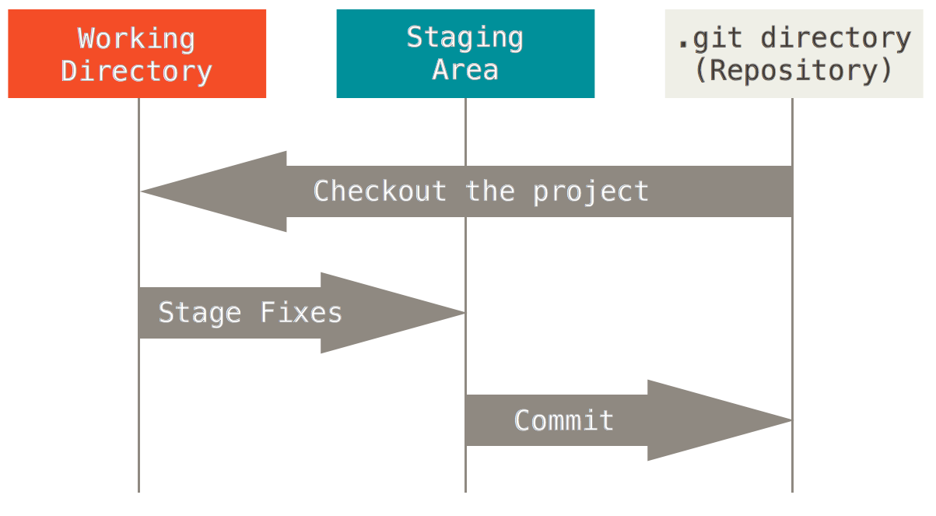
Basic terms
Local repository stored in hidden folder .git
Working directory - folder with code
Commit - snapshot of working directory
Staging area or Index -
Notes:
Git has three main states that your files can reside in: committed, modified, and staged.
Committed means that the data is safely stored in your local database.
Modified means that you have changed the file but have not committed it to your database yet.
Staged means that you have marked a modified file in its current version to go into your next commit snapshot.
The Git directory is where Git stores the metadata and object database for your project. This is the most important part of Git, and it is what is copied when you clone a repository from another computer.
The working directory is a single checkout of one version of the project. These files are pulled out of the compressed database in the Git directory and placed on disk for you to use or modify.
The staging area is a file, generally contained in your Git directory, that stores information about what will go into your next commit. It’s sometimes referred to as the “index”, but it’s also common to refer to it as the staging area.
The basic Git workflow goes something like this:
You modify files in your working directory.
You stage the files, adding snapshots of them to your staging area.
You do a commit, which takes the files as they are in the staging area and stores that snapshot permanently to your Git directory.

Slide 10
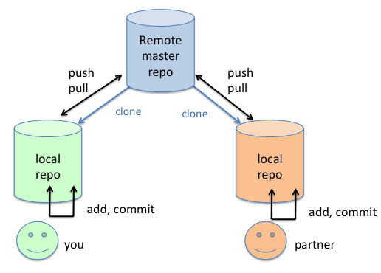
Create/clone repository
git init – create an empty local repo
git clone <URL> – create local repo from remote repo

Slide 11
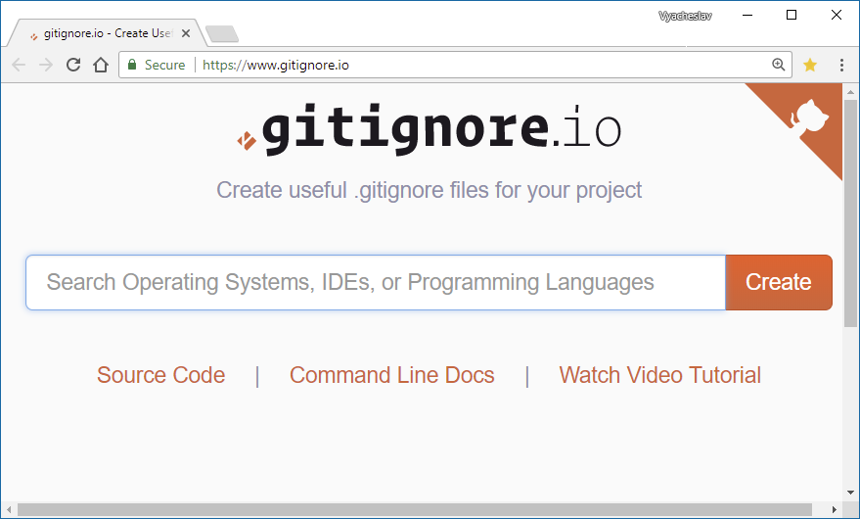
.gitignore
.gitignore - contains list of files and folders that are ignored by git in working folder
Typically ignored files:
Operating system files (Thumbs.db, .DS_Store)
Application/IDE configuration files (.vscode)
Generated files (*.exe, *.min.js)
Language/framework files (.sass_cache, npm-debug.log)
Files downloaded with package managers (node_modules)
Credentials/tokens (wp-config.php)

Slide 12
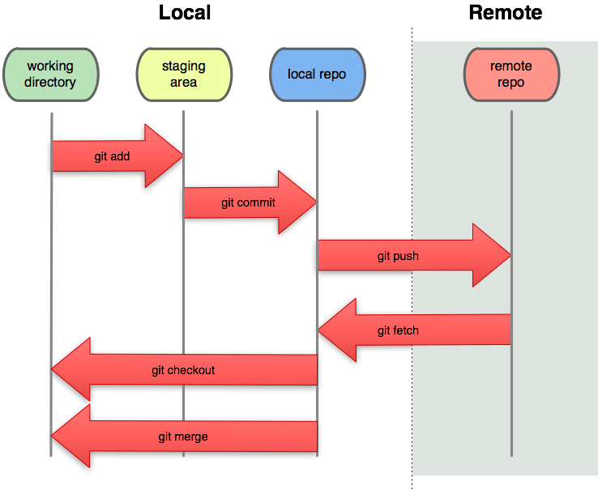
Basic git data transport commands
git add
git commit
git push
git fetch
git checkout
git merge

Slide 13
Additional important commands
Get help:
git help <command>
git <command> --help
Show status and log:
git status – Show the working tree status
git log – Show commit logs
git ls-files -s - Show files in the index
Remove and revert:
git rm – Remove files from the working tree and from the index
git reset - Resets changes
Shortcuts:
git commit -am - combines add and commit
git pull - Combines fetch and merge
Remote:
git remote -v - List remote repos
git remote add - Add remote repo
git remote rm - Remove remote repo

Slide 14
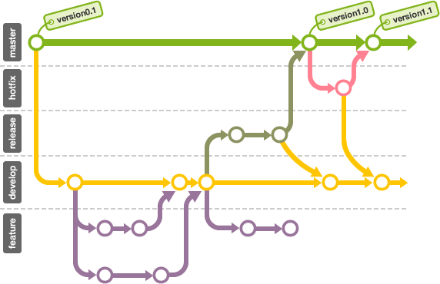
Branches
A branch represents an independent line of development.
Commands:
git branch – list of branches in local repo
git branch <name> – create new local branch named “name”
git branch –d <name> – delete the branch named “name”
git branch –m <name> – rename the current branch to “name”

Slide 15
Workflow
Clone repository
git clone
git init
Create/switch branch
git branch
git checkout
Add files to staging area
git add
Review/merge changes
git status
git log
git diff
git merge
Commit changes
git commit
Push changes to repo
git push
Get changes from remote repo
git fetch
git pull
clone repository / get changes
modify staging area
review changes
commit changes
push changes to repo
create / switch branch
15
Notes:
List of all main git commands http://git-scm.com/docs

Slide 16
Recommended links
https://git-scm.com/book/en/v2 - original documentation from Git team
https://www.atlassian.com/git/tutorials - Atlassian git tutorial
https://try.github.io - git course from codeschool
https://learngitbranching.js.org/ - practical course on git branching

Slide 17
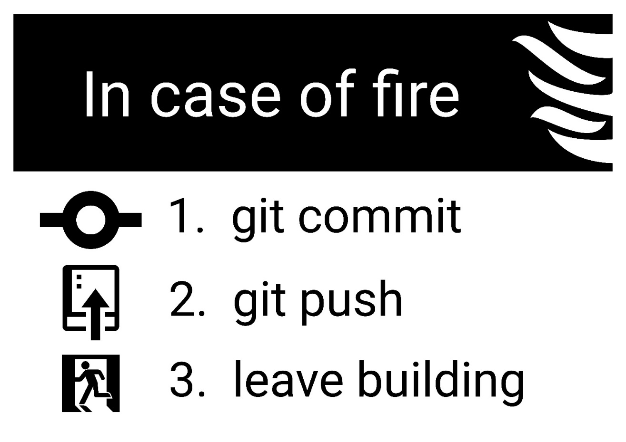
Thank you!
by Vyacheslav Koldovskyy

